Slide 1

Getting Help with Research Computing

Slide 2
Getting Help with Research Computing
Instructor: Trevor Hall
Website: www.rc.colorado.edu
Helpdesk: rc-help@colorado.edu
Slides: https://github.com/ResearchComputing/Summer_Camp_2023
Survey: http://tinyurl.com/curc-survey18

Slide 3
Learning Goals
What resources do I have available?
How do I choose which resource is best?
How can I submit an effective ticket?

Slide 4

Things to take note of:
HPC is comprised of confusing, ambiguous, highly nuanced concepts
CURC User Support is here to alleviate some of the confusion around HPC!
Ask Questions!

Slide 5
Help! I’m stuck, where do I go?
Documentation: curc.readthedocs.io/
External Resources
RMACC Cyber Infrastructure Portal
The Internet! (Man Pages, YouTube, etc.)
Trainings with Center for Research Data and Digital Scholarship
Helpdesk: rc-help@colorado.edu

Slide 6
When should I use these?
Documentation: curc.readthedocs.io/
Useful at any time! Check the documentation first when you run into issues.
External Resources
Useful for learning a new skill or initial troubleshooting. Great first place to look.
Helpdesk: rc-help@colorado.edu
Useful for quick, personalized assistance.
Trainings with Center for Research Data and Digital Scholarship
Useful for broad, long-term learning

Slide 7
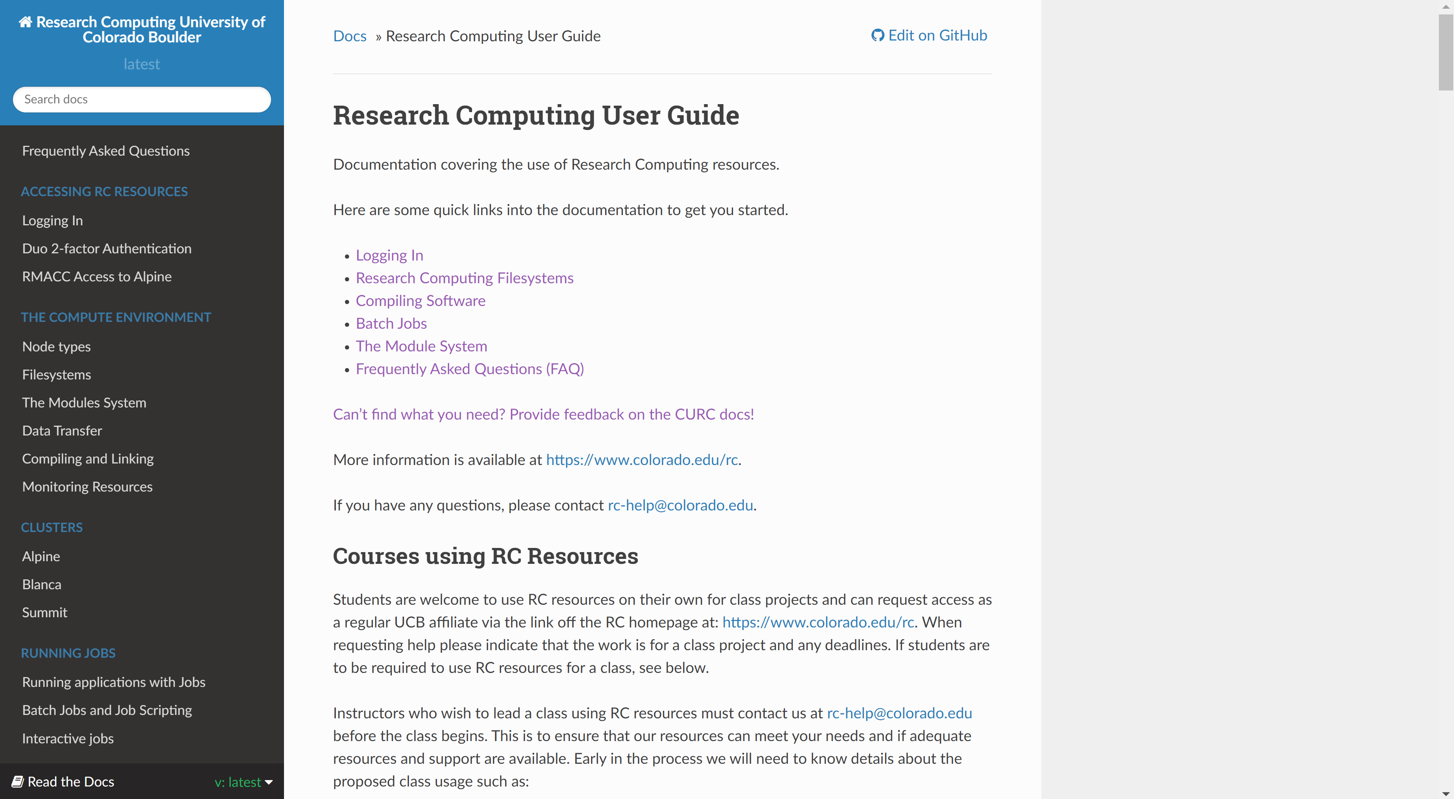
Our Documentation
Located at: https://curc.readthedocs.io/en/latest/

Slide 8
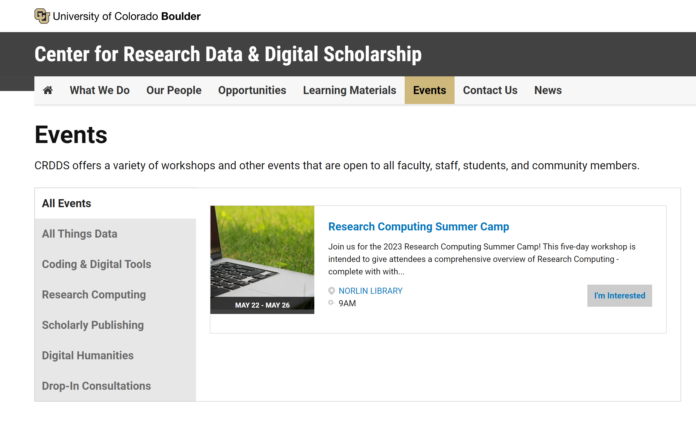
CRDDS Trainings and Workshops
View upcoming workshops at: https://www.colorado.edu/crdds/events

Slide 9

External Resources - RMACC Cyber Infrastructure Portal
https://ask.cyberinfrastructure.org/c/rmacc/65
This forum provides opportunity for RMACC members to converse amongst themselves and with the larger, global research computing community.
The “go to” general Q&A platform for the global research computing community - researchers, facilitators, research software engineers, CI engineers, sys admins and others.
Notes:
Stack exchange but for RC specifically

Slide 10
How can I submit an effective ticket?

Slide 11
Helpdesk Tickets
To: rc-help@colorado.edu
Dear Research Computing,
Help! My code won’t run! Help!
Help please, Trevor
To: rc-help@colorado.edu
Dear Research Computing,
I am running into issues running my Python script. I am using a conda environment called my_python_env with the pytorch software, and I am receiving the following error. I am not sure how to troubleshoot. My job ID is 620350. Let me know what I can try!
srun: fatal: SLURM_MEM_PER_CPU, SLURM_MEM_PER_GPU, and SLURM_MEM_PER_NODE are mutually exclusive.
Thanks, Trevor

Slide 12
How can I submit an effective ticket?
Provide detail!
Specify your goal, your Job ID (if applicable), and the issue you are encountering.
Specific error messages, error codes, or descriptions of behavior are all helpful. The more information you can provide, the better.
Provide job specifics!
Which environment or software are you using? What hardware are you taking advantage of? The more information you can provide, the better.

Slide 13
Helpdesk Tickets
To: rc-help@colorado.edu
Dear Research Computing,
Hello, I am having trouble running my job. My job ID is 620350. The job loads in 1 TB of data, on which I am running some scikit-learn operations. The job has a wall clock time of 96 hours.
Thanks, Trevor
To: rc-help@colorado.edu
Dear Research Computing,
Hello, I am having trouble running my job. My job ID is 620350. The job loads in 1 TB of data, on which I am running some scikit-learn operations. I have provided a 10GB test dataset here. The job has a wall clock time of 96 hours, but can be run with the smaller dataset in two hours.
Thanks, Trevor
[attachment: File (10GB)]

Slide 14
How can I submit an effective ticket?
Provide detail!
Scale down your workflows for testing!
It is a challenge to quickly troubleshoot massive workflows, even for us.
If you’d like us to test your workflows using data, please provide a reduced version of the data for testing purposes.

Slide 15
Helpdesk Tickets
To: trevor.hall@colorado.edu
Dear Research Computing,
I am running into issues running my Python script. I am using a conda environment called my_python_env with the pytorch software, and I am receiving the following error. I am not sure how to troubleshoot. My job ID is 620350. Let me know what I can try!
srun: fatal: SLURM_MEM_PER_CPU, SLURM_MEM_PER_GPU, and SLURM_MEM_PER_NODE are mutually exclusive.
Thanks, Trevor
To: rc-help@colorado.edu
Dear Research Computing,
I am running into issues running my Python script. I am using a conda environment called my_python_env with the pytorch software, and I am receiving the following error. I am not sure how to troubleshoot. My job ID is 620350. Let me know what I can try!
srun: fatal: SLURM_MEM_PER_CPU, SLURM_MEM_PER_GPU, and SLURM_MEM_PER_NODE are mutually exclusive.
Thanks, Trevor

Slide 16
How can I submit an effective ticket?
Provide detail!
Scale down your workflows for testing!
Email our helpdesk!
We will be significantly more responsive to emails which arrive at our helpdesk than other inboxes.
Please do not email us personally. If an issue is particularly urgent, please indicate ‘URGENT’ in the subject line of your ticket.

Slide 17
Helpdesk Tickets
To: rc-help@colorado.edu
Dear Research Computing,
Can you install pytorch for me?
Thanks, Trevor
To: rc-help@colorado.edu
Dear Research Computing,
I am looking to utilize PyTorch to use in conjunction with AMD GPUs. I have tried an anaconda installation and have so far been unsuccessful. Could you please help me complete this install?
Thanks, Trevor

Slide 18
How can I submit an effective ticket?
Provide detail!
Scale down your workflows for testing!
Email our helpdesk!
Try a few things, and let us know what you’ve tried!
We are not just being lazy – it helps us contextualize the issue.
We would likely try the same things you have – if you can eliminate potential solutions, it will help us get to a solution more quickly.

Slide 19
How can I submit an effective ticket?
Provide detail!
Scale down your workflows for testing!
Email our helpdesk!
Try a few things, and let us know what you’ve tried!

Slide 20
Items We’ve Covered
What resources do I have available?
How do I choose which resource is best?
How can I submit an effective ticket?

Slide 21
Questions?

